Slide 1
The Program Logic & Flowcharting

Slide 2
Preview
By definition, computer is only a tools that can not do anything without human being.
There should be a program that is being installed inside the system
It is important to remember that while computers are very powerful, they are not able to think or find solution to problems
On the other hand, people think creatively, find solution and then the computer carries them out.
To do it, computer needs program that must be carefully planned and developed in a computer or programming languages, to accomplish the desire task
The program also has to be written in a very concise and exact form that computer perform correctly

Slide 3
Computerization Systems
The computer system component consist of :
Hardware, i.e.
  CPU, Monitor, Printer, Other peripheral
Software, i.e.
  Operating systems,
  Application software (package and self developed)
People-ware
  System Analyst
  Programmer
  Engineer
  Operator etc
Network
  WAN, LAN, Internet
  Network peripheral

Slide 4
Software
Software, includes
  Operating systems, : i.e.
    Windows
    Linux
    Symbyan and Android
    DOS
    DOS-VS
    VMS
  Application software/program
    Package Program, i.e. Microsoft office, Microsoft Power Point, Microsoft Excel etc
    Self developed Program, i.e.SIAK STMIK, Sales Systems, Inventory systems, Human Resources Systems

Slide 5
System Architecture
Things to be concerned in designing/develop- ing Computerized Systems
  The systems architecture
  System Design
  Platform planning
  Network Planning
  Application Design
The purpose of the system development will drive the architecture and design
Among the designs, application design is the focus company must provide

Slide 6
The Application Design
The Application design
  Is the responsibility of the company to develop
  Related to the business function
  Related to what the company want to accomplish (goals)
  Restricted by company resources
Should be planned carefully – Development Cycle
Things to be concerned in designing application :
  Application design
  Input Design
  Process Design
  Output Design
  Database

Slide 7
Planning the design
Programmer should write a program without carefully thinking about it first
  Before writing a program, programmer should follow some general procedures
  This procedures is called the application development live cycle, regardless the program will be written for personal computer or mainframe.
The system development cycle consist of the following stages :
  Analyzing the problem & Reviewing the program requirements
  Designing the application
  Coding and writing the programs
  Testing the programs
  Developing the documentation

Slide 8
Developing a Program
Analyzing the problem & Reviewing the program requirements. In this stages
  Application developers should examine all aspect of the problem to be programmed
  Application developers should understand
    the output that is desired,
    the input that is needed
    The various processing procedures that must be taken place
  Application developers should also decide what language will be used to code the program
  Application developers should decide the logic to create the program and the structure of the program itself

Slide 9
Developing a program
Designing the application
  The second steps in developing application is design the program
  The application and program should be put into a pictorial form that could be easily read and understood by program developers.
  Application developers must try to draw a picture all small steps that is necessary to carry out the procedures.
  To do this programmer often create a flowchart, a diagram made of geometric symbols that illustrate how the problem will be solved. This flowchart (diagram) will mention the grade calculating programs
  Though flowchart is not the only method of designing a program, it is still the most common

Slide 10
Developing a program
Coding and writing the program
  It is a step after the application design completed. In this step, programmer will actually encode the program.
  This is the very important steps in developing an application
  The program should be developed in such a way that is :
    Easily be read / understood
    Easily accommodate changes, modifications and corrections
    Structurally correct
    Has flexibility to any other improvement
  The application developer should choose the correct programming language to solve the problem, efficient and match.
  The application developers should examine and assure that no mistake or debug in the program by testing it before being input to the computer

Slide 11
Developing a Program
Testing the programs
  This step is conducted after program being developed and in this case :
    All step or function of the program being tested
    Users should take a part during the testing to prove that programs have been developed in accordance with the business rule and good corporate governance
    Use real data though not all data being used to test
    Beside individual of variety transactions need to be tested , for a certain purpose, stressed test also need to be conducted
  Debugging, correcting and revising should be conducted until all the program perform smoothly and error free
  Users are needed to joint the test for acceptance purposes
Developing the documentation
  The last step of the program development cycle is developing documentation
  The documentation is not always in the hardcopy
  The documentation explains everything about the program including how program runs, the type data needed etc
  A good documentation of program will help developer in maintaining the program in the future.

Slide 12
Planning the design
Testing the programs
  This step is conducted after program being developed and in this case :
    All step or function of the program being tested
    Users should take a part during the testing to prove that programs have been developed in accordance with the business rule and good corporate governance
    Use real data though not all data being used to test
    Beside individual of variety transactions need to be tested , for a certain purpose, stressed test also need to be conducted
  Debugging, correcting and revising should be conducted until all the program perform smoothly and error free
  Users are needed to joint the test for acceptance purposes
Developing the documentation
  The last step of the program development cycle is developing documentation
  The documentation is not always in the hardcopy
  The documentation explains everything about the program including how program runs, the type data needed etc
  A good documentation of program will help developer in maintaining the program in the future.

Slide 13
Designing Tools
To simplify the design, designer uses tools that is commonly used in designing application systems
The tools are use to simplify the system, especially the data flow
The basic concept of outlining the data flow is still processing cycle, Input – Process - Output
The common tools used by application designer to draw the data processing and data flows are :
  Data Flow Diagram (context, & Details), a graphical representation of the "flow" of data through an information system.
  Object oriented programming languages
  Flow Chart, a diagram of the sequence of operations in a computer program
Other tools that are also needed to design an application are data dictionary, database, software development tools

Slide 14
Planning the design
Flowcharts
  A formalized graphic representation of a logic program.
  The purpose of a flow chart is to provide people with a common language or reference point when dealing with a project or process.
  The flowchart is involved in the development of program in the second stage, before start writing a program
  The flowchart was invented for the first time by John von Neumann at Princeton University,
  It is really a diagram composed of symbols, directional lines, and information of computer will use to solve a particular problems.
  The flowchart illustrates the steps required for solving the problem. It shows what should be done, not how.
  The flowchart or diagram is very important tools for programmers
  Not only present the logical element, but also provide a detail plan to add in writing program. It is also become a media communication among programmers & other technicians
  Making easy for developer to divide entire programs into small parts

Slide 15
Example : Data Flow Diagram
Customer
Marketing
PO, Cust, data
SO
DO
PO, Cust, data
Inventory Systems
PR, data supplier
SO, SR
Purchasing
Warehouse
PO
DO, PR
DO, data
Supplier
PO,
Director
Report

Slide 16
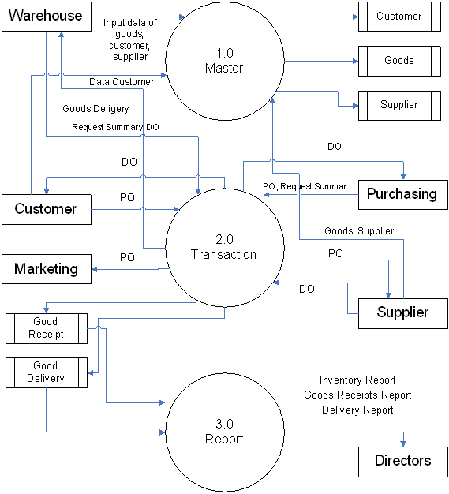

Slide 17
Examples
Start
Input
Grade
ADD
Other Grade
Print
Other student
Stop

Slide 18
Crossing the Street
Start
If you want to cross the street… Could you tell us what’s the sequential steps to be done in order you reach the cross street safely ??
1
2
3
5
4
6
7
Stop

